Slide 1
Hackathon Updated
File created on: 1/3/2022 11:57:54 pm

Slide 2
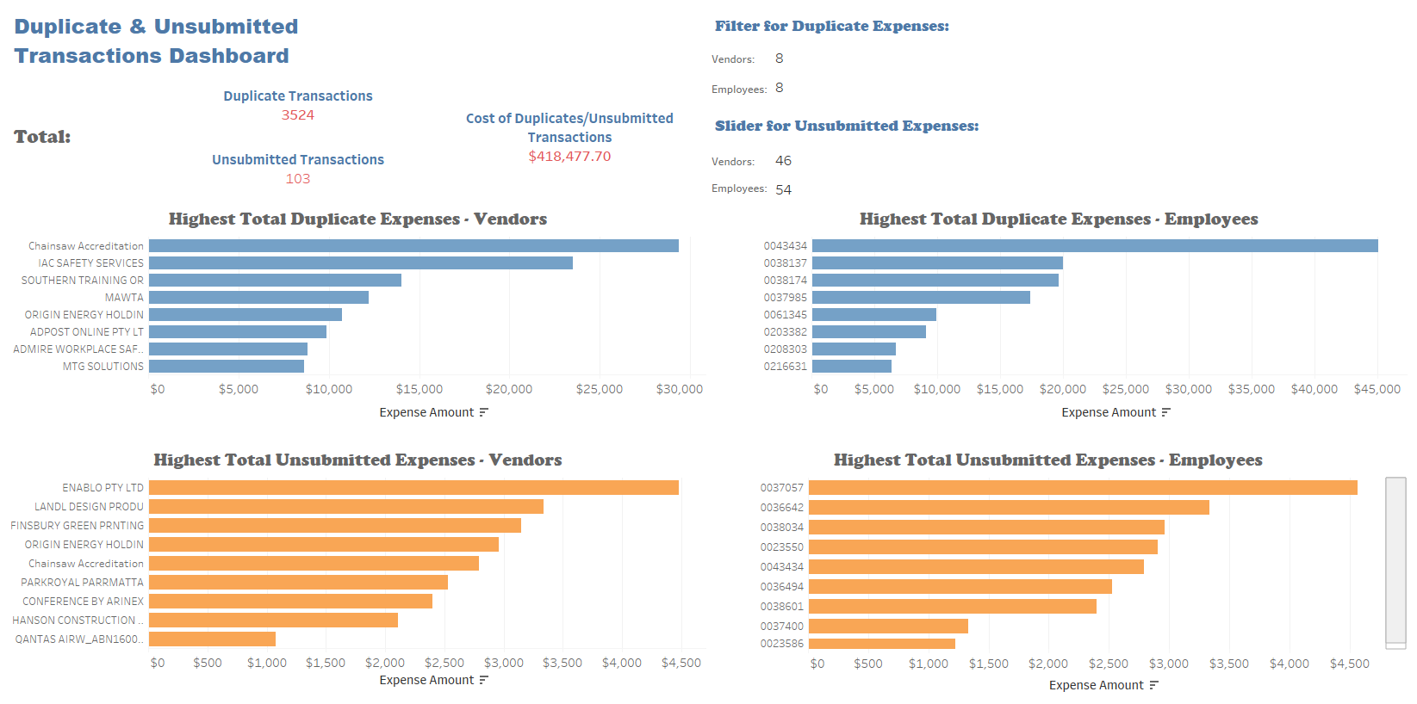

Slide 3
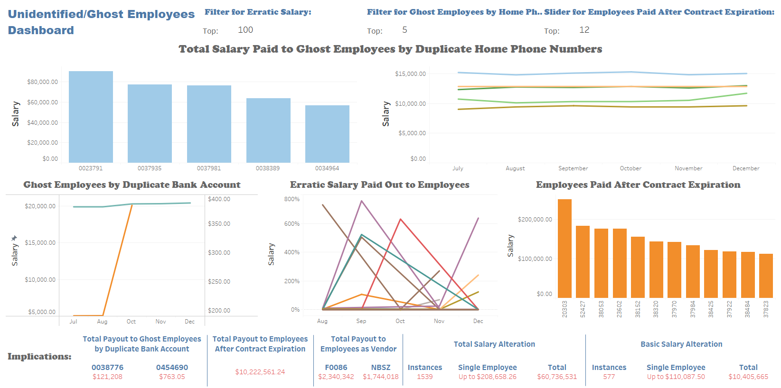

Slide 4
